Slide 1
Deep Learning in Pharma
Sean Grullon, Ph.D
Manager, Machine Learning & Data Science
Data & Computational Sciences

Slide 2
Outline
Preface: Important ‘Machine Learning Fundamentals’
What are Artificial Neural Networks?
Key technical principles of Artificial Neural Networks
Typical Deep Learning Architectures
Deep Learning Frameworks and Libraries
Applications of Deep Learning in Drug Discovery

Slide 3
Kinds of supervised machine learning problems
Classification and regression
Classification
Predicting the category or class of something from various inputs
Regression
Predicting a continuous quantity from various inputs
Performance?
Performance?
Accuracy (fraction correctly classified)
Error (fraction incorrectly classified)
RMSE (root mean square error)
Examples
Examples
Predicting a batch failure in manufacturing
Predicting if a patient will respond to a treatment
Predicting the activity of a candidate molecule
Predicting the resource needed for a project

Slide 4
The supervised machine learning framework
Prepare data,
select features,
partition data
Use training data to build models
Model selection and tuning
(validation)
Test final model
Need three sets – training, validation, testing
Note that in the literature, the meanings
of validation and test are sometimes reversed!
Notes:
NOTE: validation and testing are used in different ways by different people and there doesn’t seem to be a standard... The terminology above is most common.
A reasonable split of the data might be 50/25/25 % for train, validation, test

Slide 5

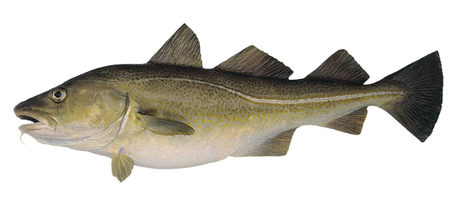
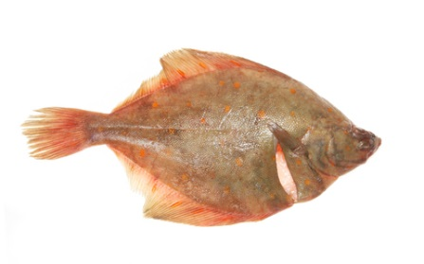
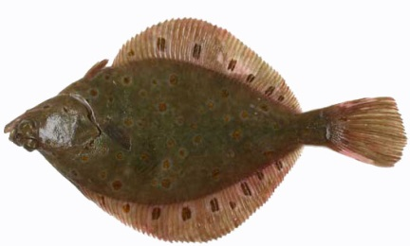
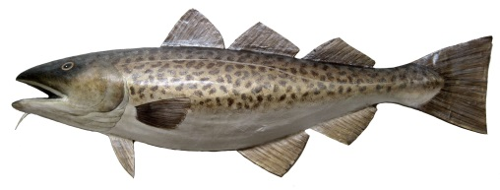

Supervised machine learning
Width | Height | Average R | Average G | Average B | Type
42.3 | 12.6 | 0.62 | 0.58 | 0.25 | ?
29.5 | 25.2 | 0.86 | 0.72 | 0.14 | ?
38.4 | 11.2 | 0.73 | 0.66 | 0.45 | ?
29.5 | 25.2 | 0.86 | 0.72 | 0.14 | ?
29.5 | 25.2 | 0.86 | 0.72 | 0.14 | ?

Slide 6

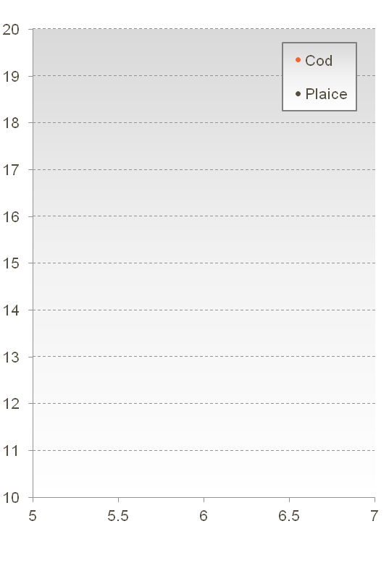
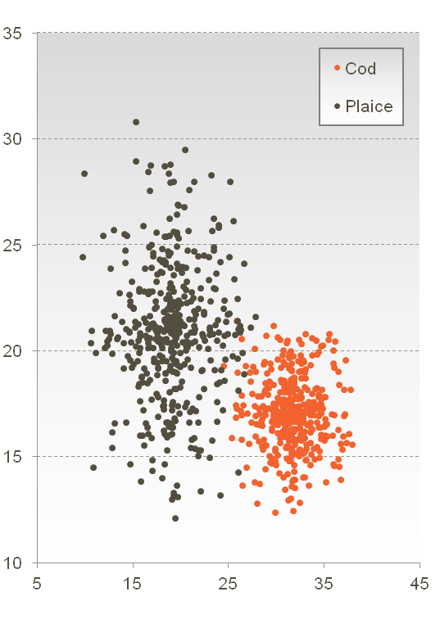
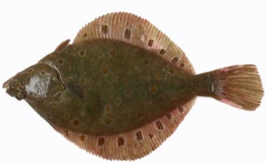
Supervised machine learning
Length | Width | Class
29.6 | 23.2 | Cod
9.9 | 8.6 | Plaice
37.2 | 18.8 | Cod
17.7 | 17.3 | Cod
18.1 | 14.0 | Plaice
28.8 | 23.1 | Cod
18.7 | 12.3 | Plaice
14.7 | 11.2 | Plaice
33.6 | 17.9 | Cod
16.3 | 10.8 | Plaice
19.6 | 16.0 | Plaice
31.2 | 17.7 | Cod
“Validation”
“Training”
Width
Separate test set to validation
Length

Slide 7
Outline
Preface: Important ‘Machine Learning Fundamentals’
What are Artificial Neural Networks?
Key technical principles of Artificial Neural Networks
Typical Deep Learning Architectures
Deep Learning Frameworks and Libraries
Applications of Deep Learning in Drug Discovery

Slide 8
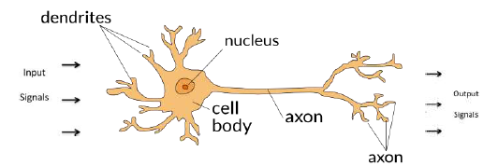
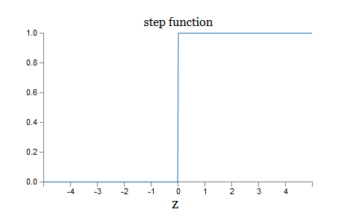
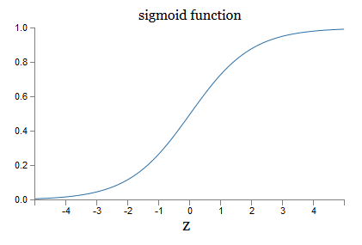
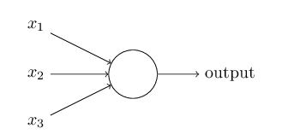
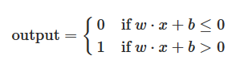
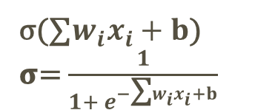
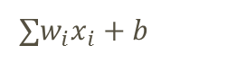
What is an Artificial Neural Network?
Direction of Signal
Collection of connected artificial neurons
Activation Function in neuron takes weighted sum of input signals and outputs a signal
∑$w_{i}x_{i}+b$
$\text{σ}$(∑$w_{i}x_{i}+b$)
𝛔= $\frac{1}{1+ e^{−\text{∑}w_{i}x_{i}+b}}$

Slide 9
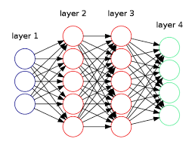
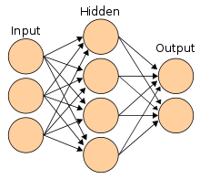
What is an Artificial Neural Network?
Direction of Signal
Neurons Organized in layers of signaling cascades
Each neuron transmits a signal to another neuron
Artificial Feed Forward Neural Network
(Single Hidden Layer)
Deep Neural Network
(Multiple Hidden Layers)

Slide 10
Supervised machine learning
Classifying Fish as ‘Cod’ or ‘Plaice’
Model
trained using an algorithm
Width
Inputs
Height
Output
Average R
Type
Average B
Average G

Slide 11
A Simple Neural Network model to classify Fish
‘Fully Connected’ Feed Forward Neural Network – nodes are connected to every subsequent node
Width
Length
Average R
Probability of fish being cod [0,1]
Average B
Average G
Input Layer
Hidden Layer
Output Layer
(for classification)

Slide 12
Outline
Preface: Important ‘Machine Learning Fundamentals’
What are Artificial Neural Networks?
Key technical principles of Artificial Neural Networks
Typical Deep Learning Architectures
Deep Learning Frameworks and Libraries
Applications of Deep Learning in Drug Discovery

Slide 13
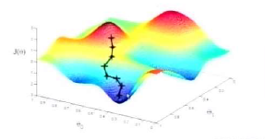
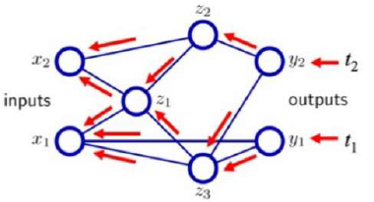
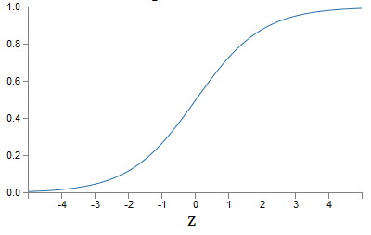
Key Technical Principles of Neural Networks
Loss Function
Optimizer
(e.g. Gradient Descent)
Performance Function
E.g RMSE
Activation Function
(e.g. Sigmoid)
Neural Network Architecture
Backpropagation

Slide 14
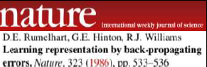
Backpropagation – The ‘Learning’ in Deep Learning
Numerical Method (published in 1986!) to calculate the error contribution of each neuron after each batch of data is processed
Used by an optimizer (Gradient Descent) to adjust the weights of a neural network by calculating the gradient of the loss function
It is called backpropagation because the error is calculated at the output and gets ‘propagated’ back through the neural network layers
Applies chain rule of calculus iteratively on each neural network layer

Slide 15
Training a Neural Network
Training Set
Width | Length | R | B | G | Class
15.2 | 30.2 | 220 | 20 | 10 | 1 (Cod)
28.4 | 18.1 | 120 | 120 | 120 | 0 (Plaice)
Etc…
Width
Length
Average R
P of cod [0,1]
Average B
Average G

Slide 16
Training a Neural Network
Initialize with Random Weights
Training Set
Width | Length | R | B | G | Class
15.2 | 30.2 | 220 | 20 | 10 | 1 (Cod)
28.4 | 18.1 | 120 | 120 | 120 | 0 (Plaice)
Etc…

Slide 17
Training a Neural Network
Present a training example
Training Set
Width | Length | R | B | G | Class
15.2 | 30.2 | 220 | 20 | 10 | 1 (Cod)
28.4 | 18.1 | 120 | 120 | 120 | 0 (Plaice)
Etc…
15.2
30.2
220
20
10

Slide 18
Training a Neural Network
Feed through to get a prediction, compare with truth
Training Set
Width | Length | R | B | G | Class
15.2 | 30.2 | 220 | 20 | 10 | 1 (Cod)
28.4 | 18.1 | 120 | 120 | 120 | 0 (Plaice)
Etc…
15.2
30.2
220
0.2
True Value: 1
Error is Huge!
20
10

Slide 19


Training a Neural Network
Adjust weights based on error
(Backpropagate)
Training Set
Width | Length | R | B | G | Class
15.2 | 30.2 | 220 | 20 | 10 | 1 (Cod)
28.4 | 18.1 | 120 | 120 | 120 | 0 (Plaice)
Etc…
15.2
30.2
220
0.2
True Value: 1
20
10

Slide 20
Training a Neural Network
And so on….
Repeat this thousands, maybe millions of times. Each time choose training example, backpropagate to make weight adjustments
Training stops after N times, or optimizer stops improving
Training Set
Width | Length | R | B | G | Class
15.2 | 30.2 | 220 | 20 | 10 | 1 (Cod)
28.4 | 18.1 | 120 | 120 | 120 | 0 (Plaice)
Etc…
28.4
18.1
120
0.7
True Value: 0
120
120

Slide 21
Want to go from this…..
Model
Width
Inputs
Height
Output
Average R
Type
Average B
Average G
Sam Genway, RDSG & Tessella

Slide 22
To this….
Use images and have the model itself find the features that discriminate the fish classes
Model
Inputs
Output
Type
Sam Genway, RDSG & Tessella

Slide 23

Consider learning an image
Some patterns are much smaller than the whole image
“Fin” detector
Represent a small region with fewer weights/parameters
The same pattern can appear anywhere in the image
“Fin” detector

Slide 24
Outline
Preface: Important ‘Machine Learning Fundamentals’
What are Artificial Neural Networks?
Key technical principles of Artificial Neural Networks
Typical Deep Learning Architectures
Deep Learning Frameworks and Libraries
Applications of Deep Learning in Drug Discovery

Slide 25
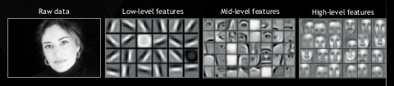
Classical Machine Learning vs Deep Learning
Deep Learning can automatically learn high-level features
Rule based
(No machine learning)
Input
Hand designed rules
Output
Classical machine learning
Input
Hand designed features
Classification/Regression
Output
Input
Features
Classification/Regresion
Output
Neural networks
Deep neural networks
Input
Simple Features
Additional layer of more abstract features
Classification/Regression
Output
Adapted from: Goodfellow, I., Bengio, Y., & Courville, A. (2016). Deep learning. MIT Press.

Slide 26
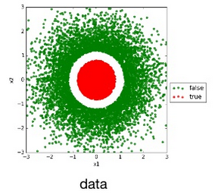
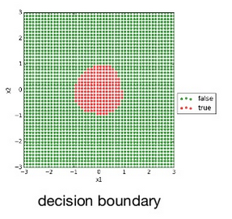
The Universal Approximation Theorem
A feed-forward neural network with a single hidden layer containing a finite number of neurons can approximate continuous functions* continuous functions on compact subsets of R^{n},
Logistic Regression can’t classify data like:
Simple Neural Network learns a non-linear decision boundary without any feature engineering
https://github.com/theeluwin/kata/blob/master/tasks/Universal%20Approximation%20Theorem/uat.py
*on compact subsets of R^{n} for nonconstant, bounded, and monotonically-increasing continuous functions

Slide 27
Example Deep Learning Architectures
It’s important that you recognize that many exist and more are being created every day. These architectures, just like software architecture patterns, are optimized for a specific problem, data type, or performance need.
Loss Function
Optimizer
(e.g. Gradient Descent)
Performance Function
E.g RMSE
Activation Function
(e.g. Sigmoid)
Neural Network Architecture
Backpropagation

Slide 28
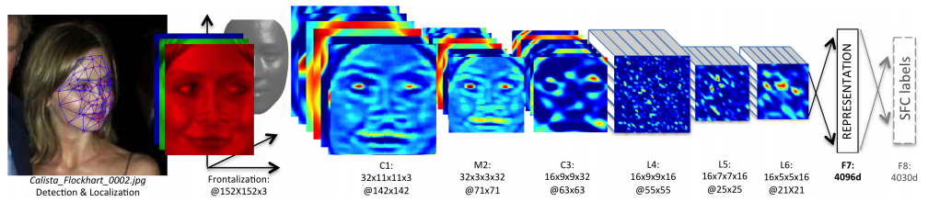
Convolutional Neural Networks
Typical Application: Image Classification
DeepFace by Facebook: World leading accuracy in Facial Recognition
Facial Recognition: Detect->Alignment->Represent->Classify
Convolutional Neural Networks (CNNs) are the bread and butter of Deep Learning

Slide 29
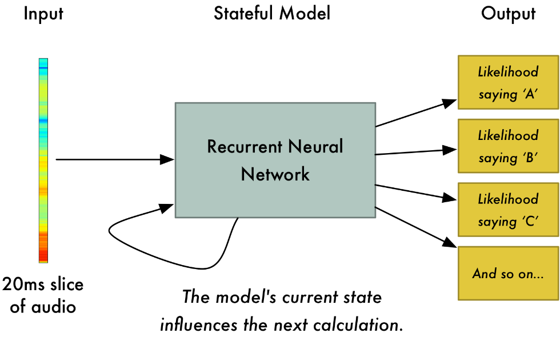
Speech Recongnition
Popular Speech Recognition technologies (Alexa, Siri) are based on Deep Learning
Recurrent Neural Networks (RNNs) handle time series and sequence data
http://proceedings.mlr.press/v48/amodei16.pdf

Slide 30

Generative Adversarial Networks (GANs)
Typical Application: Machine-generated Images
Most machine learning models are discriminative: algorithms learn differences between classes and the features responsible
GANs are generative: GANs model the distributions of individual classes

Slide 31
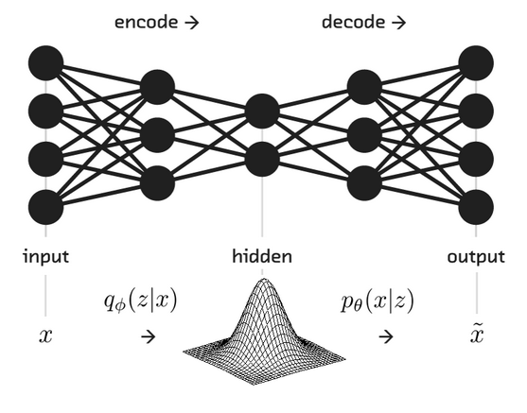




Autoencoders
Typical Application: Feature learning and dimensionality reduction
Stacked Denoising Autoencoders (SDAEs)
Goal: Reconstruct Input, learning features in the process
Unsupervised: discover hidden, explanatory variables; discover structure/clusters
Nonlinear: learns local directions of variation in the data
Scales to high dimensions
Robust to noise: e.g. SDAEs must learn to correct corrupted inputs
Variational architecture adds Gaussian stochasticity to hidden layer, incorporating Bayesian modeling techniques and giving architecture generative capability
$$𝒩\left(x,σ^{2}\right)$$
$$x$$
$$\tilde{x}$$
Encoder
Network
$$h_{1}$$
Decoder
Network
$$\hat{x}$$
$$h_{2}$$
input
corrupted
input
hidden, explanatory
variables
reconstructed
input
Variational Autoencoders (VAEs)

Slide 32
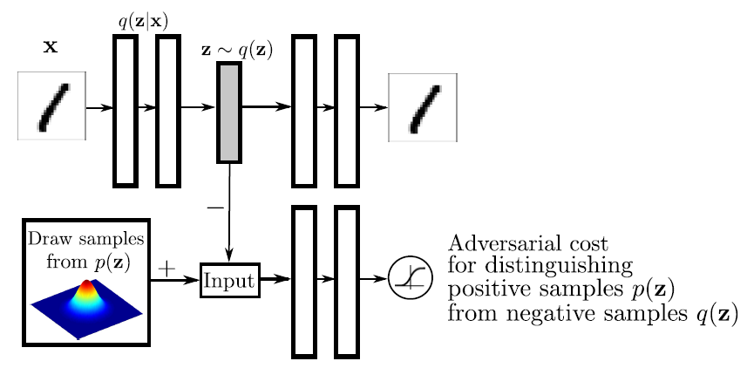
Adversarial Autoencoders: Merging Autoencoder and GAN concepts
Similar to a Variational Autoencoder, Except it replaces Gaussian Stochasticity in the hidden layer with an adversarial network like a GAN.
Also used for feature learning and dimensionality reduction, but could also be used for machine generation of data

Slide 33
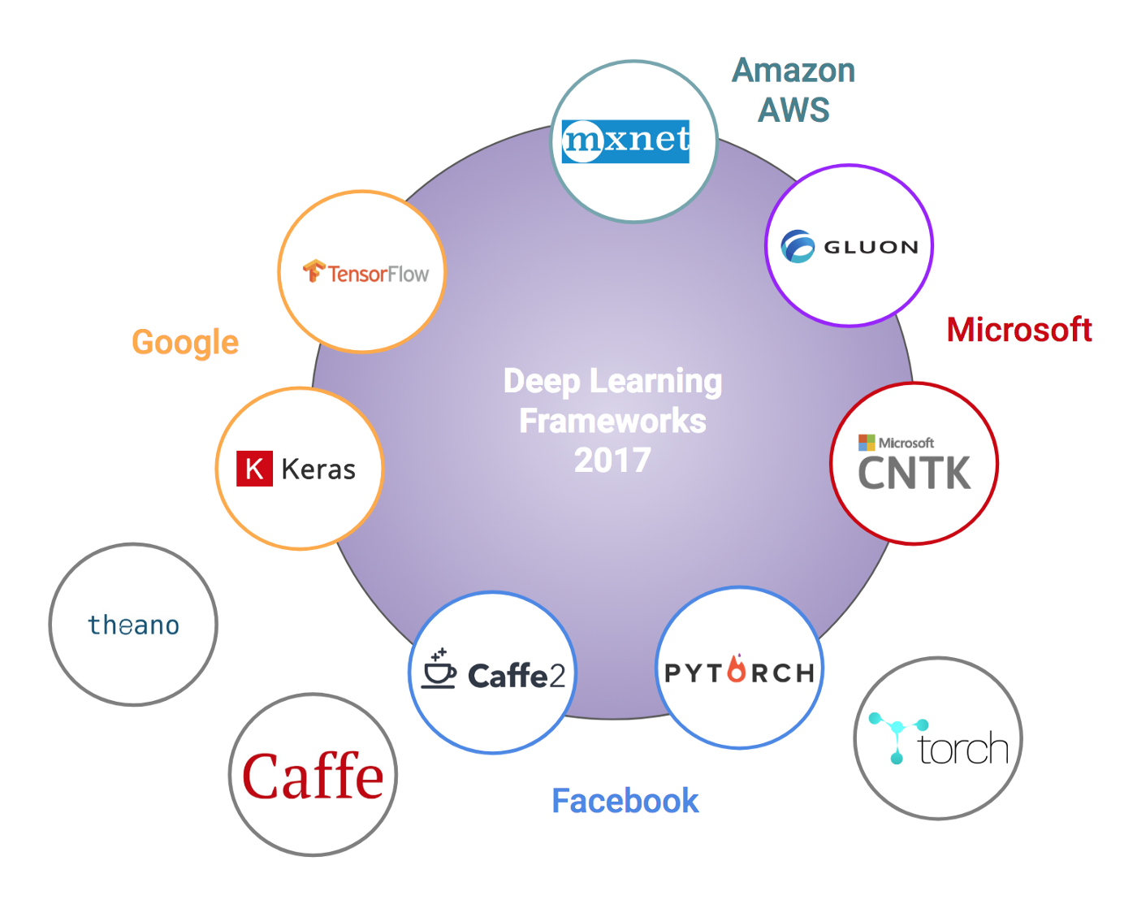

Deep Learning Frameworks and Libraries
There are a lot….
No longer being maintained

Slide 34
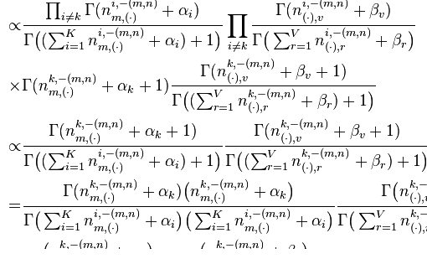

Deep Learning
What society thinks I do…
What other coworkers think I do…

Slide 35
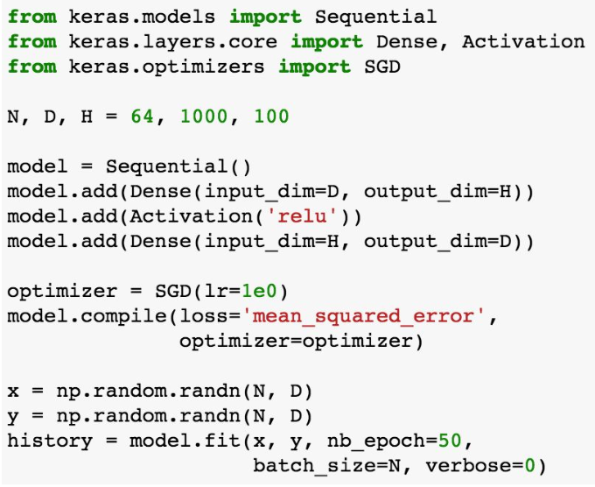
What I really do …

Slide 36
Outline
Preface: Important ‘Machine Learning Fundamentals’
What are Artificial Neural Networks?
Key technical principles of Artificial Neural Networks
Typical Deep Learning Architectures
Deep Learning Frameworks and Libraries
Applications of Deep Learning in Drug Discovery

Slide 37
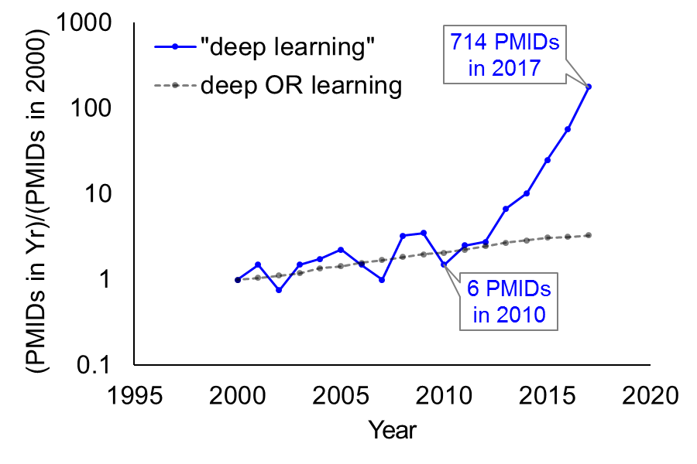
Deep Neural Networks
Growing Applications in Biology and Medicine
Explosive growth in biomedical publications on Deep Learning beginning 2010
Reviews
Ching et al. preprint. Opportunities And Obstacles For Deep Learning In Biology And Medicine.
Tran et al. 2018. Deep Omics.
Miotto et al. 2017. Deep learning for healthcare: review, opportunities and challenges.
Min et al. 2017. Deep learning in bioinformatics.
Mamoshina et al. 2016. Applications of Deep Learning in Biomedicine.
Angermueller et al. 2016. Deep learning for computational biology.
Rampasek et al. 2016. TensorFlow: Biology's Gateway to Deep Learning?
Ekins et al. 2016. The Next Era: Deep Learning in Pharmaceutical Research.
Gawehn et al. 2016. Deep Learning in Drug Discovery.
LeCun et al. 2015. Deep Learning.
Slide Credit: Andrew Rouillard

Slide 38

Drug Development Process
Target
Identification
Lead
Discovery
Medicinal Chemistry
In Vitro
Studies
In Vivo
Studies
Clinical
Trials
- Cellular & Genetic Targets
- Genomics
- RNASeq
- Proteomics
- Synthesis
- Combinatorial Chemistry
- Assays
- High-throughput screening
- Activity Studies
-Chemical Synthesis
-Structure optimization
- Drug affinity and selectivity
-Cellular models
-Lead Candidate selecton
- Efficacy in animal models
- Animal models
- Toxicology
Efficacy and toxicology in humans
38±19% more medicines with genetic targets that are twice as good (at constant budget) Hurle et al. NRDD 15, 596–597 (2016)

Slide 39
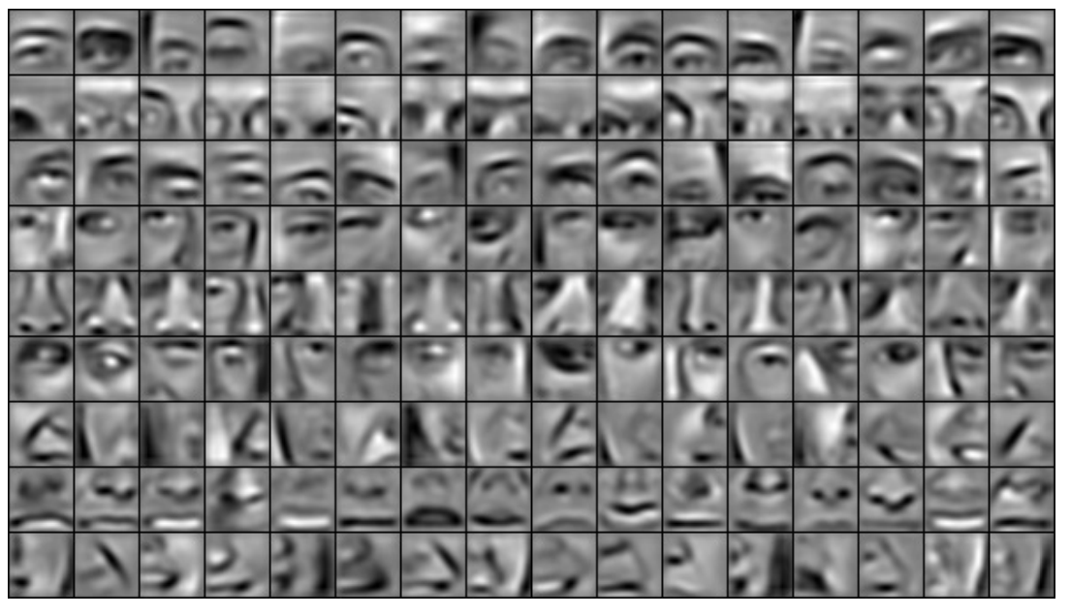
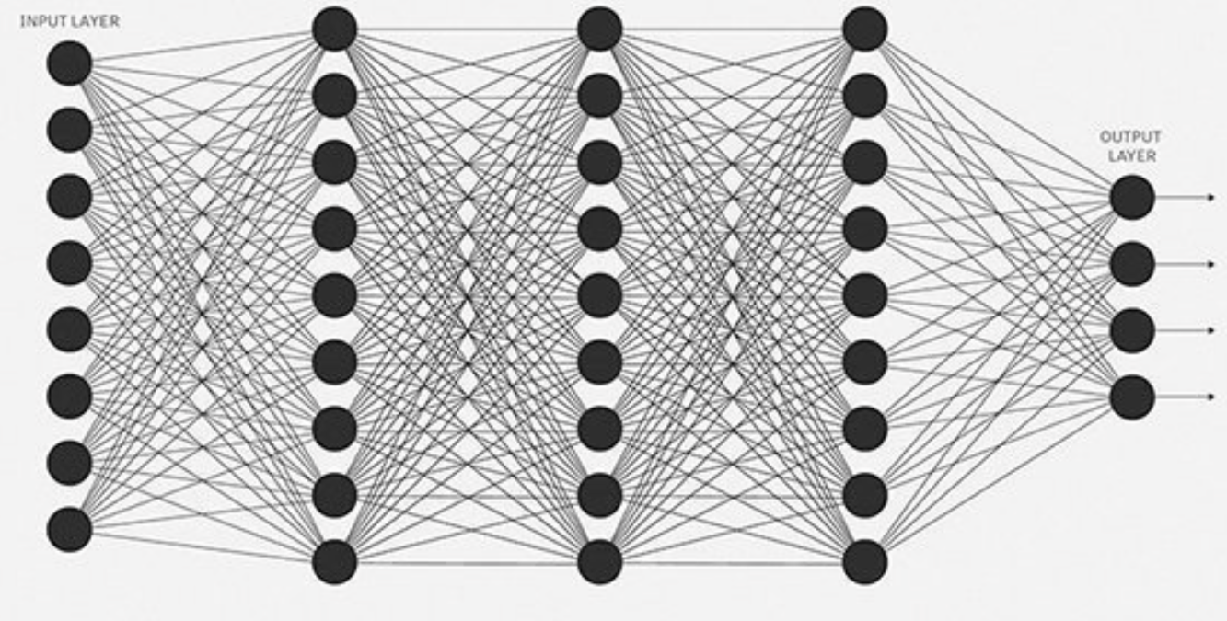
Target ID: Transcriptomics Deep Learning
Deep learning constructs complex features automatically
Line Shape E.g. Eye Face
Gene Motif Signature Pathway score
Simple feature ( network gets deeper…) Complex feature
Deep neural networks can be trained to be robust to noise and simple transformations

Slide 40
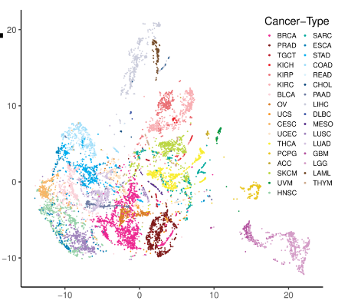
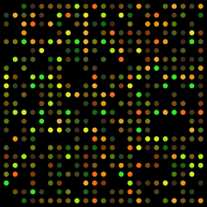
Transcriptomics Deep Learning
Deep Learning can automatically identify cancer subtypes
tSNE
Public Tx data
Variational Autoencoder
Casey Greene and Gregory Way University of Pennsylvania: https://www.biorxiv.org/content/early/2017/10/02/174474

Slide 41
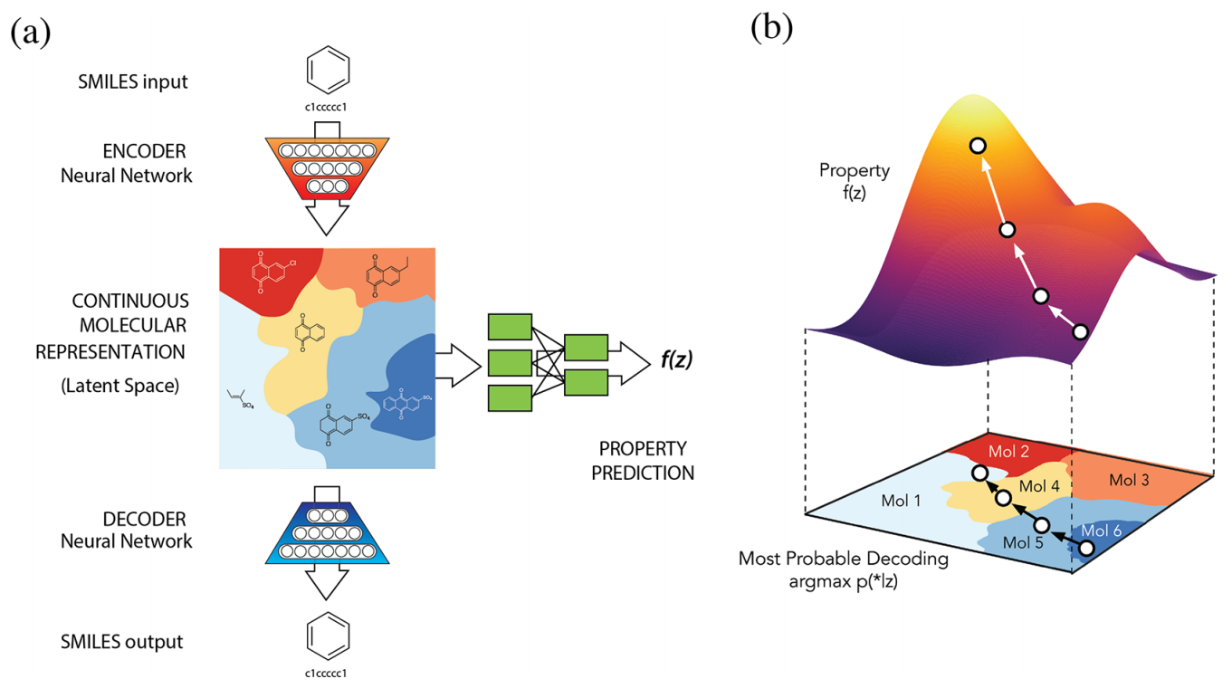
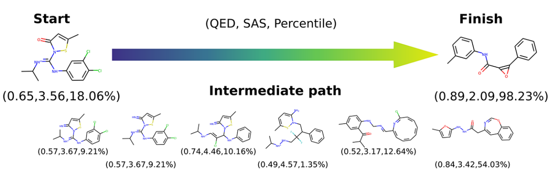
Lead Discovery - Automatic chemical design using a data-driven continuous representation of molecules
Biomedical datasets are often high-dimensional, with multivariate, nonlinear relationships among variables. Deep auto-encoders excel at nonlinear dimensionality reduction, learning latent variables that explain complex patterns of variation in the observed data (e.g. substructures that explain differences between small molecules). Generative models enable prediction of realistic but as yet unobserved data (e.g. feasible variations of a small molecule to enhance a property of interest).
Chemical
structure
INPUT
Predicted variations to optimize property of interest
Encoder
network
Low-dim
latent
space
Property of interest as a function of latent variables
Property
prediction
network
Decoder
network
Chemical
structure
OUTPUT
Gomez-Bombarelli et al. Automatic chemical design using a data-driven continuous representation of molecules. ACS Cent Sci. 2018.

Slide 42
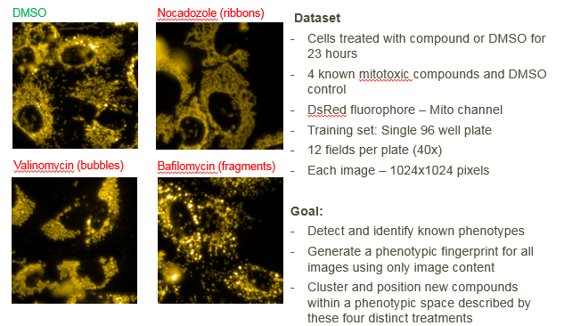
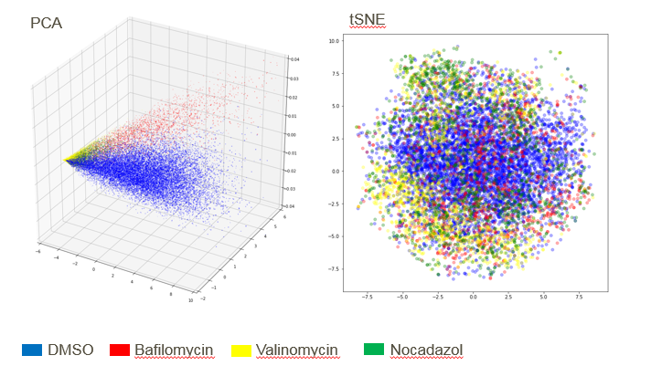
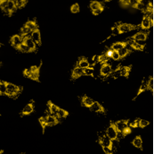
In-Vitro: Using deep learning to phenotype cellular images
Drawing more power directly from data, less subjectivity, higher information content
Training data (4 phenotypes)
Input image
Model output
Visualize/track cellular phenotype
1 channel image
Training set: Single 384 well plate
12 field per plate (40x)
1024x1024 pixels
Bafilo
Noca
?
DMSO
Generate a phenotypic fingerprint
Deep Learning
model
DMSO
1%
Noca
17%
Bafilo
82%
Valino
0%
Ann Hoffman, Yusuf Roohani

Slide 43

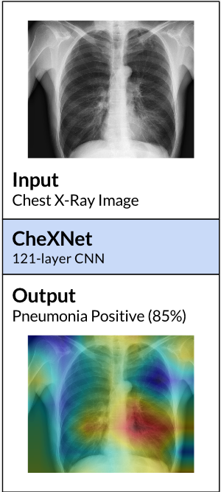
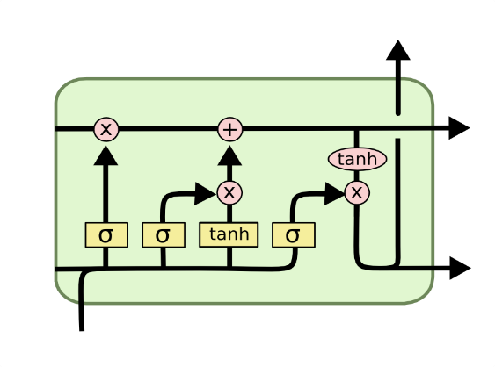
Clinical Trials
Augment structured clinical trial features with unstructured data
Adverse Events Meta-analysis
Risk Score reevaluation
Could one derive a more accurate risk
Score for respiratory diseases
and quantify the impact on
patient outcomes?
CheXNet
Stanford ML lab
https://arxiv.org/abs/1711.05225
LSTM
How do patterns of adverse events uncovered
by a deep learning model compare to standard
Adverse events databases?
Notes:
Eg Pulmonary Edema, lung floods with fluid – can you derive more quantitative risk scores?

Slide 44
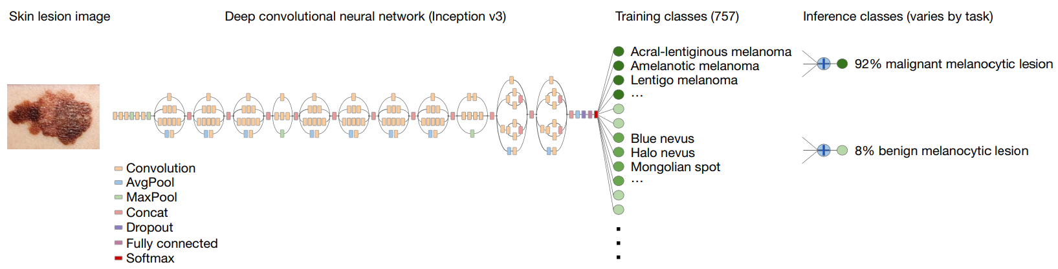
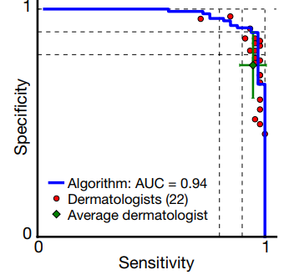
Dermatologist-level classification of skin cancer with deep neural networks
Many medical diagnoses are made by visual inspection. Convolutional Neural Networks (CNNs) excel at learning relationships between features in images and classifications (e.g. diagnoses).
INPUT:
Skin Lesion Image
Convolutional Neural Network
Training Classes
OUTPUT:
Diagnosis Probabilities
Performance on
Melanoma
Diagnosis
Esteva et al. Dermatologist-level classification of skin cancer with deep neural networks. Nature. 2017.

